Slide 1

Anomaly Detection Using Artificial Intelligence
Identifying abnormal patterns in complex data systems
By: Omar Khader , Zaid Ardah, Mahmoud Abdelghafor
Prof. Mohammed Awad
Arab American University
May 2026

Slide 2

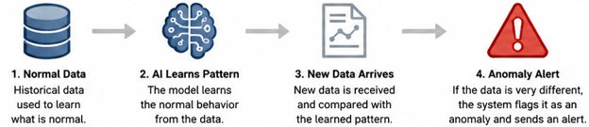
Understanding Anomaly Detection
Introduction
Anomaly detection uses intelligence to figure out what normal data looks like and find things that do not fit in. This helps organizations see when something is not right. Anomaly detection does this by looking for things that're different from what is normally expected. It can help organizations find problems like fraud or mistakes in the system. It can also help them see when something strange is going on. Anomaly detection is really good, at finding these kinds of problems so organizations can fix them quickly.

Slide 3
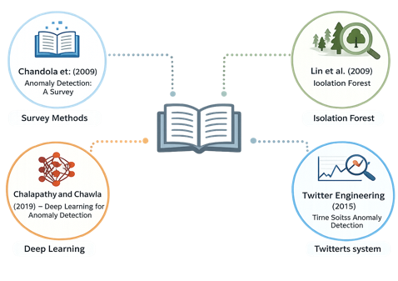
Previous Uses of Anomaly Detection
Related Literature / Previous Works
Chandola et al. (2009) – Anomaly Detection: A Survey :
A Survey, looked at all the ways to detect anomalies and where they are used. The authors pointed out that detecting anomalies is very important in areas, such as keeping computers and networks safe helping people get better in hospitals and stopping fake money transactions.
Liu et al. (2008) – Isolation Forest :
This method, called the Isolation Forest algorithm is used a lot now. It works by finding data points that're very different from normal ones, which are usually easy to spot because they are rare.
Chalapathy and Chawla (2019) – Deep Learning for Anomaly Detection :
The study looked at using learning to find anomalies in complex datasets. It talked about the things about deep learning models as well as the problems and limitations that come with using them.
Twitter Engineering (2015) – Time-Series Anomaly Detection :
Twitter Engineering came up with a way to detect anomalies in time-series data in 2015. They proposed a method called Seasonal Hybrid ESD, which's very good at finding unusual patterns in data that changes over time. This technique is especially useful for finding changes, which makes it good, for watching what is happening in real-time.

Slide 4
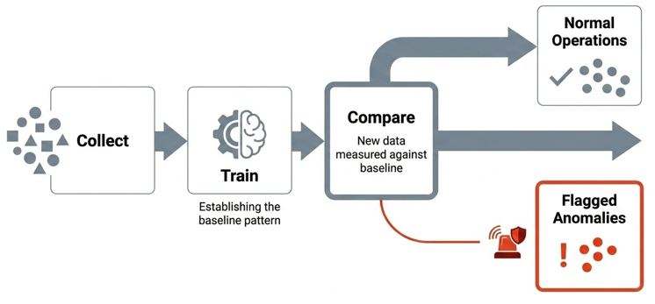
How Anomaly Detection Works
Anomaly Detection Workflow
How AI improves it:
Faster detection
Real-time monitoring
Finds hidden patterns
Reduces manual work
Helps prevent problems early
Anomaly detection is a way to find things that do not look right in information. It uses computers to look at data and learn what is normal. Then when new information comes in it can see if something is different. This helps companies find issues fast and do something about them. Anomaly detection is really good at finding things that're not like the other things, in the information. So, companies can use anomaly detection to stay on top of things and fix problems before they get big.

Slide 5
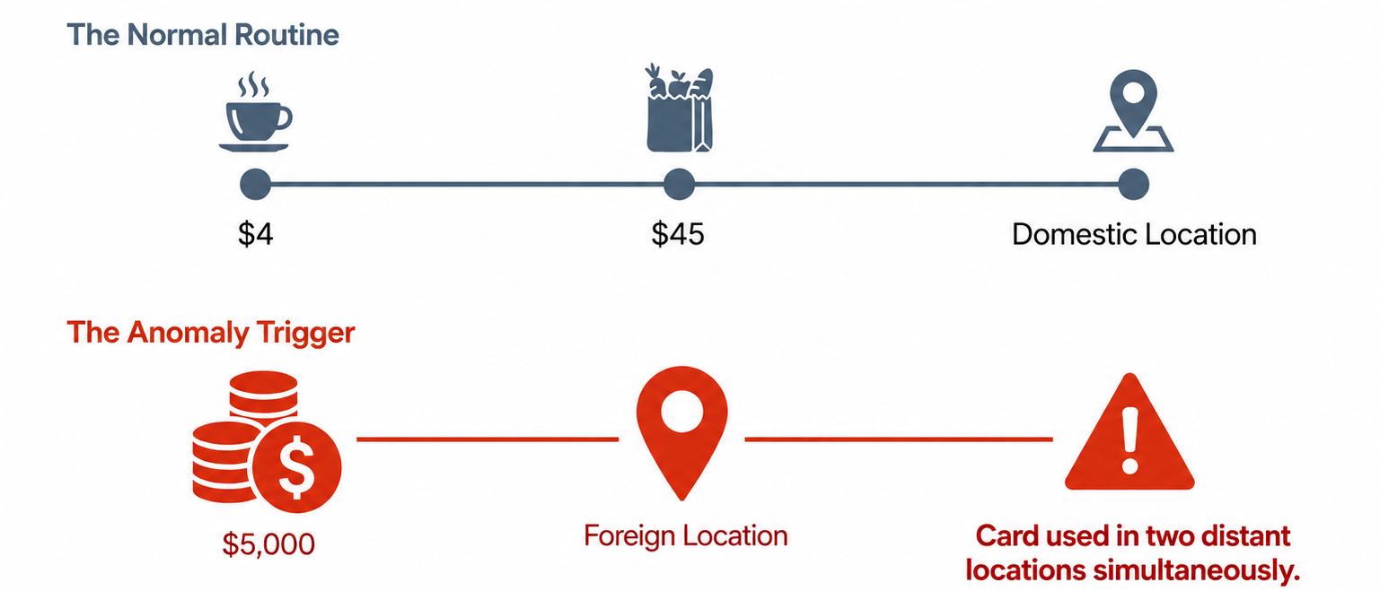
Real-World Example: Fraud Detection in Banking
Real-World Example
Anomaly detection is really important in the banking sector because it helps find financial transactions.
AI systems look at what a customer does like how they spend their money, where they are, what device they use and when they make transactions. When a new transaction is very different from what the customer does the system says it might be fake and sends an alert so someone can look into it more.
Example:
If a customer usually buys things near their home but then makes a big purchase, from another country the system might think this is weird.
Benefits:
Anomaly detection helps banks stop fraud from happening keeps customers safe and reduces money losses by finding transactions as they happen.

Slide 6
Recommendations for Effective Anomaly Detection
Recommendations
To use anomaly detection effectively:
We need to make sure we are using correct data when we are teaching AI models.
The AI models have to be used in areas like banking and healthcare where we need to find problems early.
We also need to use systems that check everything all the time so we can find things that are happening and do something about them right away.
We have to be careful not to get many false warnings because that can make people not trust the system and they might miss important warnings.
We need to update the AI models all the time so they can keep up with the things that are happening.
The AI models should work with people who're experts so they can check the important warnings and help us make good decisions, about what to do.

Slide 7
Conclusion: Why Anomaly Detection Matters
Conclusion
Anomaly detection is a useful thing that helps companies find weird patterns and possible problems before they get out of hand. This thing is great because it makes companies safer reduces the chance of bad things happening and helps people make decisions on time. Anomaly detection is very important, for types of businesses because it does all these things.

